Slide 1
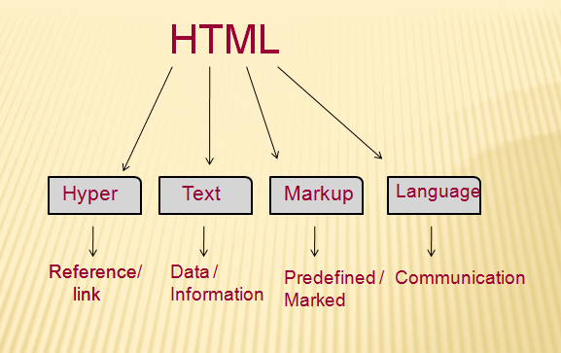
Introduction to HTML

Slide 2
HTML stands for Hypertext Markup Language, and it is the most widely used language to write Web Pages.
Hyper means reference link, text means data, mark-up means predefined, language means something that needs to communicate.
Hypertext refers to the way in which Web pages (HTML documents) are linked together. Thus, the link available on a webpage is called Hypertext.
As its name suggests, HTML is a Markup Language which means you use HTML to simply "mark-up" a text document with tags that tell a Web browser how to structure it to display.
What is HTML (Hypertext Markup Language)?
HTML is the language for publishing web pages on the WWW (World-Wide Web).
HTML is a Document Description or Document Markup Language).
HTML is NOT a programming language like C/C++/C#/Java, which is used to implement programming algorithm.
An HTML document is a text document, and it is human-readable.
HTML is TAG driven language. HTML is an interpreted language.
HTML is the mother language of Web. HTML is NOT case sensitive.
HTML is the client side scripting language i.e., used to design static web page.

Slide 3
What is HTML (HyperText Markup Language)?
HTML is the language for publishing web pages on the WWW (World-Wide Web, or World-Wide Wait?).
HTML is a Document Description Language (aka Document Markup Language). HTML is NOT a programming language like C/C++/C#/Java, which is used to implement programming algorithm.
An HTML document is a text document, and it is human-readable.

Slide 4
Originally, HTML was developed with the intent of defining the structure of documents like headings, paragraphs, lists, and so forth to facilitate the sharing of scientific information between researchers.
Now, HTML is being widely used to format web pages with the help of different tags available in HTML language.
Editor used to design the HTML static web page are notepad or notepad++.
Every HTML script will be executed in any web browser.
Basic HTML Document
In its simplest form, following is an example of an HTML document −
<!DOCTYPE html>
<html>
<head>
<title>This is document title</title>
</head>
<body>
<h1>This is a heading</h1>
<p>Document content goes here.....</p>
</body>
</html>

Slide 5
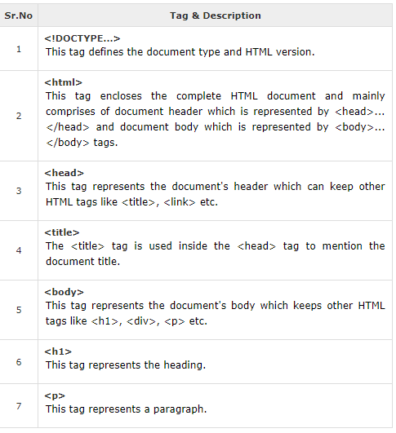
HTML Tags
HTML is a markup language and makes use of various tags to format the content.
These tags are enclosed within angle braces <Tag Name>.
Except few tags, most of the tags have their corresponding closing tags.
For example, <html> has its closing tag </html> and <body> tag has its closing tag </body> tag etc.
Above example of HTML document uses the following tags −

Slide 6
HTML Document Structure
A typical HTML document will have the following structure −
<html>
<head>
Document header related tags
</head>
<body>
Document body related tags
</body>
</html>
The <!DOCTYPE> Declaration
The <!DOCTYPE> declaration tag is used by the web browser to understand the version of the HTML used in the document.
Current version of HTML is 5 and it makes use of the following declaration −
<!DOCTYPE html>
There are many other declaration types which can be used in HTML document depending on what version of HTML is being used.

Slide 7
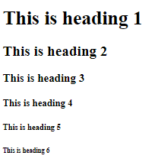
Heading Tags
Any document starts with a heading. You can use different sizes for your headings. HTML also has six levels of headings, which use the elements <h1>, <h2>, <h3>, <h4>, <h5>, and <h6>. While displaying any heading, browser adds one line before and one line after that heading.
Example
<!DOCTYPE html>
<html>
<head>
<title>Heading Example</title>
</head>
<body>
<h1>This is heading 1</h1>
<h2>This is heading 2</h2>
<h3>This is heading 3</h3>
<h4>This is heading 4</h4>
<h5>This is heading 5</h5>
<h6>This is heading 6</h6>
</body>
</html>
This will produce the following result −

Slide 8
Paragraph Tag
The <p> tag offers a way to structure your text into different paragraphs. Each paragraph of text should go in between an opening <p> and a closing </p> tag as shown below in the example −
Example
<!DOCTYPE html>
<html>
<head>
<title>Paragraph Example</title>
</head>
<body>
<p>Here is a first paragraph of text.</p>
<p>Here is a second paragraph of text.</p>
<p>Here is a third paragraph of text.</p>
</body>
</html>
This will produce the following result −
Here is a first paragraph of text.
Here is a second paragraph of text.
Here is a third paragraph of text.

Slide 9
Line Break Tag
Whenever you use the <br /> element, anything following it starts from the next line. This tag is an example of an empty element, where you do not need opening and closing tags, as there is nothing to go in between them.
The <br /> tag has a space between the characters br and the forward slash. If you omit this space, older browsers will have trouble rendering the line break, while if you miss the forward slash character and just use <br> it is not valid in XHTML.
Example
<!DOCTYPE html>
<html>
<head>
<title>Line Break Example</title>
</head>
<body>
<p>Hello<br />
You delivered your assignment ontime.<br />
Thanks<br />
Mahnaz</p>
</body>
</html>
This will produce the following result −
Hello
You delivered your assignment on time.
Thanks
Mahnaz

Slide 10
Centering Content
You can use <center> tag to put any content in the center of the page or any table cell.
Example
<!DOCTYPE html>
<html>
<head>
<title>Centring Content Example</title>
</head>
<body>
<p>This text is not in the center.</p>
<center>
<p>This text is in the center.</p>
</center>
</body>
</html>
This will produce following result −
This text is not in the center.
This text is in the center.

Slide 11

Horizontal Lines
Horizontal lines are used to visually break-up sections of a document. The <hr> tag creates a line from the current position in the document to the right margin and breaks the line accordingly.
For example, you may want to give a line between two paragraphs as in the given example below −
<!DOCTYPE html>
<html>
<head>
<title>Horizontal Line Example</title>
</head>
<body>
<p>This is paragraph one and should be on top</p>
<hr />
<p>This is paragraph two and should be at bottom</p>
</body>
</html>
This will produce the following result −
Again <hr /> tag is an example of the empty element, where you do not need opening and closing tags, as there is nothing to go in between them.
The <hr /> element has a space between the characters hr and the forward slash. If you omit this space, older browsers will have trouble rendering the horizontal line, while if you miss the forward slash character and just use <hr> it is not valid in XHTML

Slide 12
Preserve Formatting
Sometimes, you want your text to follow the exact format of how it is written in the HTML document. In these cases, you can use the preformatted tag <pre>.
Any text between the opening <pre> tag and the closing </pre> tag will preserve the formatting of the source document.
<!DOCTYPE html>
<html>
<head>
<title>Preserve Formatting Example</title>
</head>
<body>
<pre>
function testFunction( strText ){
alert (strText)
}
</pre>
</body>
</html>
This will produce the following result −
function testFunction( strText ){
alert (strText)
}
Try using the same code without keeping it inside <pre>...</pre> tags

Slide 13
Nonbreaking Spaces
Suppose you want to use the phrase "12 Angry Men." Here, you would not want a browser to split the "12, Angry" and "Men" across two lines −
An example of this technique appears in the movie "12 Angry Men."
In cases, where you do not want the client browser to break text, you should use a nonbreaking space entity &nbsp; instead of a normal space. For example, when coding the "12 Angry Men" in a paragraph, you should use something similar to the following code −
<!DOCTYPE html>
<html>
<head>
<title>Nonbreaking Spaces Example</title>
</head>
<body>
<p>An example of this technique appears in the movie "12&nbsp;Angry&nbsp;Men."</p>
</body>
</html>
This will produce the following result −
An example of this technique appears in the movie "12 Angry Men."

Slide 14
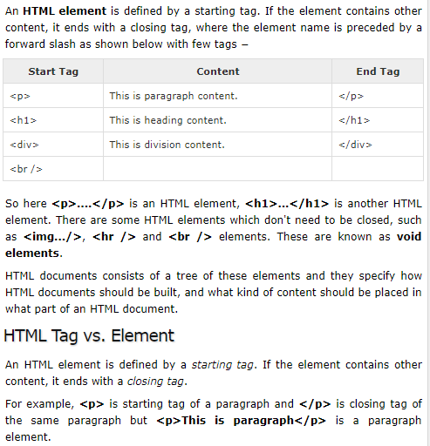
HTML – Elements

Slide 15
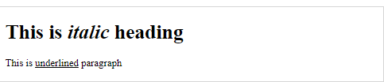
Nested HTML Elements
It is very much allowed to keep one HTML element inside another HTML element −
<!DOCTYPE html>
<html>
<head>
<title>Nested Elements Example</title>
</head>
<body>
<h1>This is <i>italic</i> heading</h1>
<p>This is <u>underlined</u> paragraph</p>
</body>
</html>
This will display the following result −

Slide 16
HTML- Attributes
We have seen few HTML tags and their usage like heading tags <h1>, <h2>, paragraph tag <p> and other tags. We used them so far in their simplest form, but most of the HTML tags can also have attributes, which are extra bits of information.
An attribute is used to define the characteristics of an HTML element and is placed inside the element's opening tag. All attributes are made up of two parts − a name and a value
The name is the property you want to set. For example, the paragraph <p> element in the example carries an attribute whose name is align, which you can use to indicate the alignment of paragraph on the page.
The value is what you want the value of the property to be set and always put within quotations. The below example shows three possible values of align attribute: left, center and right.

Slide 17
Attribute names and attribute values are case-insensitive. However, the World Wide Web Consortium (W3C) recommends lowercase attributes/attribute values in their HTML 4 recommendation.
<!DOCTYPE html>
<html>
<head>
<title>Align Attribute Example</title>
</head>
<body>
<p align = "left">This is left aligned</p>
<p align = "center">This is center aligned</p>
<p align = "right">This is right aligned</p>
</body>
</html>
This will display the following result −
This is left aligned
This is center aligned
This is right aligned

Slide 18
Core Attributes
The four core attributes that can be used on the majority of HTML elements (although not all) are −
Id
Title
Class
Style
The Id Attribute
The id attribute of an HTML tag can be used to uniquely identify any element within an HTML page. There are two primary reasons that you might want to use an id attribute on an element −
If an element carries an id attribute as a unique identifier, it is possible to identify just that element and its content.
If you have two elements of the same name within a Web page (or style sheet), you can use the id attribute to distinguish between elements that have the same name.
We will discuss style sheet in separate tutorial. For now, let's use the id attribute to distinguish between two paragraph elements as shown below.
Example
<p id = "html">This para explains what is HTML</p>
<p id = "css">This para explains what is Cascading Style Sheet</p>

Slide 19
The title Attribute
The title attribute gives a suggested title for the element. They syntax for the title attribute is similar as explained for id attribute −
The behavior of this attribute will depend upon the element that carries it, although it is often displayed as a tooltip when cursor comes over the element or while the element is loading.
<!DOCTYPE html>
<html>
<head>
<title>The title Attribute Example</title>
</head>
<body>
<h3 title = "Hello HTML!">Titled Heading Tag Example</h3>
</body>
</html>
This will produce the following result −
Titled Heading Tag Example
Now try to bring your cursor over "Titled Heading Tag Example" and you will see that whatever title you used in your code is coming out as a tooltip of the cursor.

Slide 20
The style Attribute
The style attribute allows you to specify Cascading Style Sheet (CSS) rules within the element.
<!DOCTYPE html>
<html>
<head>
<title>The style Attribute</title>
</head>
<body>
<p style = "font-family:arial; color:#FF0000;">Some text...</p>
</body>
</html>
This will produce the following result −
Some text...
At this point of time, we are not learning CSS, so just let's proceed without bothering much about CSS. Here, you need to understand what are HTML attributes and how they can be used while formatting content.

Slide 21
HTML- Formatting
HTML - Formatting
If you use a word processor, you must be familiar with the ability to make text bold, italicized, or underlined; these are just three of the ten options available to indicate how text can appear in HTML and XHTML.
Bold Text
Anything that appears within <b>...</b> element, is displayed in bold as shown below −
<!DOCTYPE html>
<html>
<head>
<title>Bold Text Example</title>
</head>
<body>
<p>The following word uses a <b>bold</b> typeface.</p>
</body>
</html>
This will produce the following result −
The following word uses a bold typeface.

Slide 22
Italic Text
Anything that appears within <i>...</i> element is displayed in italicized.
Underlined Text
Anything that appears within <u>...</u> element, is displayed with underline.
Strike Text
Anything that appears within <strike>...</strike> element is displayed with strikethrough, which is a thin line through the text.
Superscript Text
The content of a <sup>...</sup> element is written in superscript; the font size used is the same size as the characters surrounding it but is displayed half a character's height above the other characters.
Subscript Text
The content of a <sub>...</sub> element is written in subscript; the font size used is the same as the characters surrounding it, but is displayed half a character's height beneath the other characters.

Slide 23
HTML- Comments
Comment is a piece of code which is ignored by any web browser. It is a good practice to add comments into your HTML code, especially in complex documents, to indicate sections of a document, and any other notes to anyone looking at the code. Comments help you and others understand your code and increases code readability.
HTML comments are placed in between <!-- ... --> tags. So, any content placed with-in <!-- ... --> tags will be treated as comment and will be completely ignored by the browser.
<!DOCTYPE html>
<html>
<head> <!-- Document Header Starts -->
<title>This is document title</title>
</head> <!-- Document Header Ends -->
<body>
<p>Document content goes here.....</p>
</body>
</html>
This will produce the following result without displaying the content given as a part of comments −
Document content goes here.....

Slide 24
Valid vs Invalid Comments
Comments do not nest which means a comment cannot be put inside another comment. Second the double-dash sequence "--" may not appear inside a comment except as part of the closing --> tag. You must also make sure that there are no spaces in the start-of comment string.
Here, the given comment is a valid comment and will be wiped off by the browser.
<!DOCTYPE html>
<html>
<head>
<title>Valid Comment Example</title>
</head>
<body>
<!-- This is valid comment -->
<p>Document content goes here.....</p>
</body>
</html>
This will produce the following result −
Document content goes here.....

Slide 25
But, following line is not a valid comment and will be displayed by the browser. This is because there is a space between the left angle bracket and the exclamation mark.
<!DOCTYPE html>
<html>
<head>
<title>Invalid Comment Example</title>
</head>
<body>
< !-- This is not a valid comment -->
<p>Document content goes here.....</p>
</body>
</html>
This will produce the following result −
< !-- This is not a valid comment -->
Document content goes here.....

Slide 26
HTML- Multi line comments
So far we have seen single line comments, but HTML supports multi-line comments as well.
You can comment multiple lines by the special beginning tag <!-- and ending tag --> placed before the first line and end of the last line as shown in the given example below.
<!DOCTYPE html>
<html>
<head>
<title>Multiline Comments</title>
</head>
<body>
<!--
This is a multiline comment and it can
span through as many as lines you like.
-->
<p>Document content goes here.....</p>
</body>
</html>
This will produce the following result −
Document content goes here.....

Slide 27
HTML - Images
Images are very important to beautify as well as to depict many complex concepts in simple way on your web page. This tutorial will take you through simple steps to use images in your web pages.
Insert Image
You can insert any image in your web page by using <img> tag. Following is the simple syntax to use this tag.
<img src = "Image URL" ... attributes-list/>
The <img> tag is an empty tag, which means that, it can contain only list of attributes and it has no closing tag.
To try following example, let's keep our HTML file test.htm and image file test.png in the same directory −
<!DOCTYPE html>
<html>
<head>
<title>Using Image in Webpage</title>
</head>
<body>
<p>Simple Image Insert</p>
<img src = "C:\Java_Training_2018\earth.jpg" alt = “3.8 Billion miles from EARTH" />
</body>
</html>
You can use PNG, JPEG or GIF image file based on your comfort but make sure you specify correct image file name in src attribute. Image name is always case sensitive.
The alt attribute is a mandatory attribute which specifies an alternate text for an image, if the image cannot be displayed.

Slide 28

HTML- Table
The HTML tables allow web authors to arrange data like text, images, links, other tables, etc. into rows and columns of cells.
The HTML tables are created using the <table> tag in which the <tr> tag is used to create table rows and <td> tag is used to create data cells. The elements under <td> are regular and left aligned by default
<!DOCTYPE html>
<html>
<head>
<title>HTML Tables</title>
</head>
<body>
<table border = "1">
<tr>
<td>Row 1, Column 1</td>
<td>Row 1, Column 2</td>
</tr>
<tr>
<td>Row 2, Column 1</td>
<td>Row 2, Column 2</td>
</tr>
</table>
</body>
</html>
This will produce the following result −
Here, the border is an attribute of <table> tag and it is used to put a border across all the cells. If you do not need a border, then you can use border = "0".

Slide 29
HTML- Lists
HTML offers web authors three ways for specifying lists of information. All lists must contain one or more list elements. Lists may contain −
<ul> − An unordered list. This will list items using plain bullets.
<ol> − An ordered list. This will use different schemes of numbers to list your items.
<dl> − A definition list. This arranges your items in the same way as they are arranged in a dictionary.
HTML Unordered Lists
An unordered list is a collection of related items that have no special order or sequence. This list is created by using HTML <ul> tag. Each item in the list is marked with a bullet.
<!DOCTYPE html>
<html>
<head>
<title>HTML Unordered List</title>
</head>
<body>
<ul>
<li>Beetroot</li>
<li>Ginger</li>
<li>Potato</li>
<li>Radish</li>
</ul>
</body>
</html> Beetroot
Ginger
Potato
Radish

Slide 30
HTML- Text links
A webpage can contain various links that take you directly to other pages and even specific parts of a given page. These links are known as hyperlinks.
Hyperlinks allow visitors to navigate between Web sites by clicking on words, phrases, and images. Thus you can create hyperlinks using text or images available on a webpage.
Note − I recommend you to go through a short tutorial on Understanding URL
Linking Documents
A link is specified using HTML tag <a>. This tag is called anchor tag and anything between the opening <a> tag and the closing </a> tag becomes part of the link and a user can click that part to reach to the linked document. Following is the simple syntax to use <a> tag.
<a href = "Document URL" ... attributes-list>Link Text</a>
Let's try following example which links http://www.tutorialspoint.com at your page −
<!DOCTYPE html>
<html>
<head>
<title>Hyperlink Example</title>
</head>
<body>
<p>Click following link</p>
<a href = "https://www.google.com" target = "_self">Google</a>
</body>
</html>
.

Slide 31
HTML- Marquees
An HTML marquee is a scrolling piece of text displayed either horizontally across or vertically down your webpage depending on the settings. This is created by using HTML <marquees> tag.
Note − The <marquee> tag deprecated in HTML5. Do not use this element, instead you can use JavaScript and CSS to create such effects.
Syntax
A simple syntax to use HTML <marquee> tag is as follows −
<marquee attribute_name = "attribute_value"....more attributes>
One or more lines or text message or image
</marquee>

Slide 32
HTML- fonts
Fonts play a very important role in making a website more user friendly and increasing content readability. Font face and color depends entirely on the computer and browser that is being used to view your page but you can use HTML <font> tag to add style, size, and color to the text on your website. You can use a <basefont> tag to set all of your text to the same size, face, and color.
The font tag is having three attributes called size, color, and face to customize your fonts. To change any of the font attributes at any time within your webpage, simply use the <font> tag. The text that follows will remain changed until you close with the </font> tag. You can change one or all of the font attributes within one <font> tag.
Set Font Size
You can set content font size using size attribute. The range of accepted values is from 1(smallest) to 7(largest). The default size of a font is 3.
<!DOCTYPE html>
<html>
<head>
<title>Setting Font Size</title>
</head>
<body>
<font size = "1">Font size = "1"</font><br />
<font size = "2">Font size = "2"</font><br />
<font size = "3">Font size = "3"</font><br />
<font size = "4">Font size = "4"</font><br />
<font size = "5">Font size = "5"</font><br />
<font size = "6">Font size = "6"</font><br />
<font size = "7">Font size = "7"</font>
</body>
</html>

Slide 33
HTML-CSS3
Cascading Style Sheets (CSS) describe how documents are presented on screens, in print, or perhaps how they are pronounced. W3C has actively promoted the use of style sheets on the Web since the consortium was founded in 1994.
Cascading Style Sheets (CSS) provide easy and effective alternatives to specify various attributes for the HTML tags. Using CSS, you can specify a number of style properties for a given HTML element. Each property has a name and a value, separated by a colon (:). Each property declaration is separated by a semi-colon (;).
Example
First let's consider an example of HTML document which makes use of <font> tag and associated attributes to specify text color and font size −

Slide 34
<!DOCTYPE html>
<html>
<head>
<title>HTML CSS</title>
</head>
<body>
<p><font color = "green" size = "5">Hello, World!</font></p>
</body>
</html>
We can re-write above example with the help of Style Sheet as follows −
<!DOCTYPE html>
<html>
<head>
<title>HTML CSS</title>
</head> <body>
<p style = "color:green; font-size:24px;" >Hello, World!</p>
</body>
</html>
This will produce the following result.
Hello, World!

Slide 35
You can use CSS in three ways in your HTML document.
External Style Sheet − Define style sheet rules in a separate .css file and then include that file in your HTML document using HTML <link> tag.
Internal Style Sheet − Define style sheet rules in header section of the HTML document using <style> tag.
Inline Style Sheet − Define style sheet rules directly along-with the HTML elements using style attribute.
Let's see all the three cases one by one with the help of suitable examples.

Slide 36
External Style Sheet
If you need to use your style sheet to various pages, then its always recommended to define a common style sheet in a separate file. A cascading style sheet file will have extension as .css and it will be included in HTML files using <link> tag.
Example
Consider we define a style sheet file style.css which has following rules −
.red {
color: red;
}
.thick {
font-size:20px;
}
.green {
color:green;
}

Slide 37
External Style Sheet
Here we defined three CSS rules which will be applicable to three different classes defined for the HTML tags. I suggest you should not bother about how these rules are being defined because you will learn them while studying CSS. Now let's make use of the above external CSS file in our following HTML document −
<!DOCTYPE html>
<html>
<head>
<title>HTML External CSS</title>
<link rel = "stylesheet" type = "text/css" href = "/html/style.css">
</head>
<body>
<p class = "red">This is red</p>
<p class = "thick">This is thick</p>
<p class = "green">This is green</p>
<p class = "thick green">This is thick and green</p>
</body>
</html>
This is red
This is thick
This is green
This is thick and green

Slide 38
Internal Style Sheet
If you want to apply Style Sheet rules to a single document only, then you can include those rules in header section of the HTML document using <style> tag.
Rules defined in internal style sheet overrides the rules defined in an external CSS file
Let's re-write above example once again, but here we will write style sheet rules in the same HTML document using <style> tag −
<!DOCTYPE html>
<html>
<head>
<title>HTML Internal CSS</title>
<style type = "text/css">
.red {
color: red;
}
.thick{
font-size:20px;
}
.green {
color:green;
}
</style>
</head>
<body>
<p class = "red">This is red</p>
<p class = "thick">This is thick</p>
<p class = "green">This is green</p>
<p class = "thick green">This is thick and green</p>
</body>
</html>

Slide 39
Inline Style Sheet
You can apply style sheet rules directly to any HTML element using style attribute of the relevant tag. This should be done only when you are interested to make a particular change in any HTML element only.
Rules defined inline with the element overrides the rules defined in an external CSS file as well as the rules defined in <style> element.
Let's re-write above example once again, but here we will write style sheet rules along with the HTML elements using style attribute of those elements.
<!DOCTYPE html>
<html>
<head>
<title>HTML Inline CSS</title>
</head>
<body>
<p style = "color:red;">This is red</p>
<p style = "font-size:20px;">This is thick</p>
<p style = "color:green;">This is green</p>
<p style = "color:green;font-size:20px;">This is thick and green</p>
</body>
</html>

Slide 40
HTML - JavaScript
A script is a small piece of program that can add interactivity to your website. For example, a script could generate a pop-up alert box message, or provide a dropdown menu. This script could be written using JavaScript or VBScript.
You can write various small functions, called event handlers using any of the scripting language and then you can trigger those functions using HTML attributes.
Now-a-days, only JavaScript and associated frameworks are being used by most of the web developers, VBScript is not even supported by various major browsers.
You can keep JavaScript code in a separate file and then include it wherever it's needed, or you can define functionality inside HTML document itself. Let's see both the cases one by one with suitable examples.

Slide 41
External JavaScript
If you are going to define a functionality which will be used in various HTML documents then it's better to keep that functionality in a separate JavaScript file and then include that file in your HTML documents. A JavaScript file will have extension as .js and it will be included in HTML files using <script> tag.
Consider we define a small function using JavaScript in script.js which has following code −
function Hello() {
alert("Hello, World");
}
Now let's make use of the above external JavaScript file in our following HTML document −
<!DOCTYPE html>
<html>
<head>
<title>Javascript External Script</title>
<script src = "/html/script.js" type = "text/javascript"/></script>
</head>
<body>
<input type = "button" onclick = "Hello();" name = "ok" value = "Click Me" />
</body>
</html>

Slide 42


